Slide 1
Topic: Linear inequalities
EQ: How to solve linear inequalities?

Slide 2
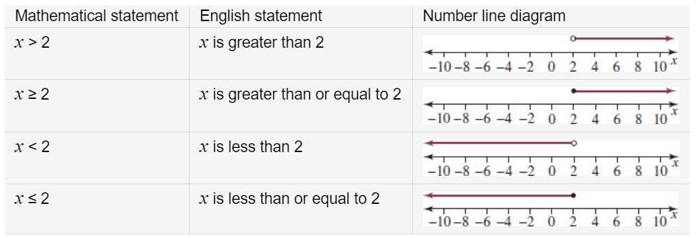
24
7
30
Topic: Linear Inequalities
Date
EQ – How to solve linear inequalities?
An equation is a statement of equality such as x = 2
An inequality is a statement of inequality such as x< 2 (x is less than 2).
The solution to a linear equation is a single point on a number line, but the solution to an inequality is a portion of the number line- the solution to the inequality has many values.
The following table shows four types of simple inequations and their corresponding representation on a number line.
What is an inequality?
Note: An open circle placed over the 2 indicates that 2 is not included; that is, 2 does not satisfy the inequality statement.
A closed or solid circle indicates that 2 is included; that is, it does satisfy the inequality statement.

Slide 3
24
7
30
Topic: Linear Inequalities
Date
EQ – How to solve linear inequalities?
The basic technique for solving inequality is to:
imagine that in place of the inequality sign, there is an equals sign
solve the inequality as if it were a linear equation, except that in place of the equals sign keep the original inequality sign unless the special case outlined below applies- we will do these examples later
How to solve an inequality?

Slide 4
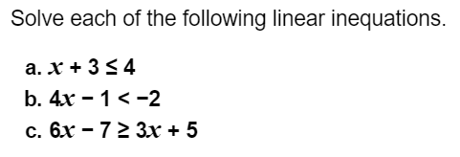
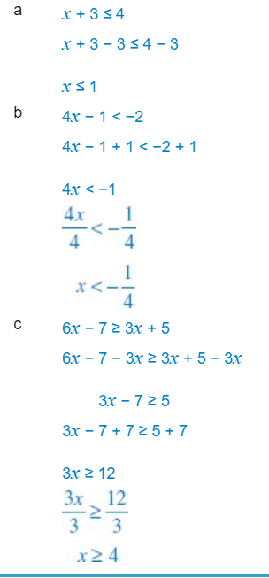
Worked examples: We will do these together
Solutions:

Slide 5
24
7
30
Topic: Linear Inequalities
Date
EQ – How to solve linear inequalities?
The special case — multiplying or dividing both sides of the inequation by a negative number
How to solve an inequality when we multiply or divide by a negative number?
Consider the inequation 6 > 5 (6 is greater than 5).If we multiply both sides of the inequation by −1 we get:
−6 > −5, which is not correct.
In fact −6 < −5.
Applying this to inequalities generally, when we multiply or divide an inequality by a negative number, the direction of the inequality sign must change.
< to > > to < ≤ to ≥ ≥ to ≤

Slide 6
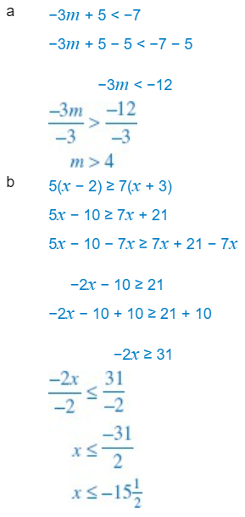
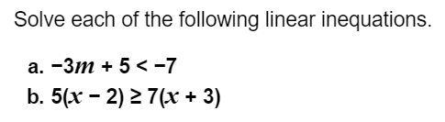
Worked examples: We will do these together
Solutions:

Slide 7
Complete “Puzzling Inequations 1 worksheet - students will need a ruler

